Slide 1


DEPARTMENT OF INFORMATION TECHNOLOGY
SCHOOL OF COMPUTING
10214IT602 MINOR PROJECT -2
WINTER SEMESTER(2024-2025)
SEMESTER END PROJECT VIVA EXAMINATION
“Health Forecaster Multi-Disease Prediction System”
PRESENTED BY
SUPERVISED BY
Dr. C. Sureshkumar, M.E., Ph.D.
1 A. NANCY MARY (VTU 21371)(22UEIT0040)
2. G. HARIHARAN (VTU 26714)(22UEIT2002)
3. S. MOHAMED SHAREEF (VTU 21445)(22UEIT0034)

Slide 2
OVERVIEW
ABSTRACT
OBJECTIVE
INTRODUCTION
LITERATURE REVIEW
DESIGN AND METHODOLOGIES
IMPLEMENTATION
TESTING
INPUT AND OUTPUT
CONCLUSION
WEB REFERENCE LINK
PLAGIARISM REPORT OF PPT
REFERENCES

Slide 3
ABSTRACT
As healthcare data becomes more abundant, machine learning is proving to be a powerful tool for disease prediction and diagnosis. This project aims to develop a multi-disease prediction system using advanced machine learning techniques to enhance early diagnosis and support effective treatment planning.
The proposed model can predict multiple diseases such as diabetes, heart disease and parkin's disease. If left untreated, these diseases pose a risk to humanity. As a result, many lives can be saved by early detection and diagnosis of these disorders.
The proposed model leverages various supervised learning algorithms including logistic regression, support vector machines (SVM), to analyze patient data and predict the likelihood of multiple diseases such as diabetes, heart disease, and parkin's disease.
The dataset used comprises key clinical parameters and patient health records, preprocessed to handle missing values and enhance model performance. Feature selection techniques are applied to identify the most relevant predictors, improving accuracy and efficiency. The model is trained and evaluated using metrics such as accuracy, precision, recall, and F1-score to ensure robustness.
Experimental results demonstrate that the proposed system achieves high prediction accuracy, making it a valuable tool for healthcare professionals in early diagnosis and preventive care.

Slide 4
OBJECTIVES
Aim of the project
Enabling early detection of potential health risks, which allows for timely interventions and reduces disease progression.
Ensuring accessibility for users, including healthcare professionals and individuals, especially in remote or underserved areas.
Creating a cost-effective solution that reduces healthcare expenses by minimizing the need for expensive treatments and hospitalizations.
Scope of the Project
Utilization of machine learning algorithms to analyze patient data, ensuring accurate and reliable predictions.
Optimizes resource utilization in hospitals and clinics by aiding healthcare professionals in decision making.
Provides valuable insights for policymakers and public health authorities by analyzing aggregated data trends.

Slide 5
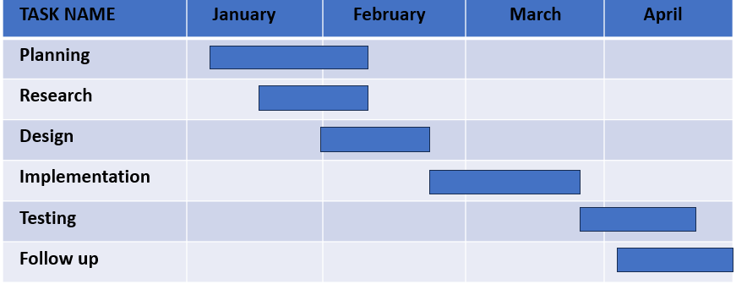
TIMELINE OF THE PROJECT
Gantt chart for Health Forecaster Multi-Disease Prediction System

Slide 6
INTRODUCTION
The Health Forecaster Multi-Disease Prediction System has the potential to make a significant impact on individual health, healthcare systems, and society at large.
The healthcare paradigm is shifting from treatment to prevention. This project supports early diagnosis and prevention, which can save lives, reduce healthcare costs, and improve quality of life.
Rural and remote areas often lack access to advanced medical facilities. This system can bridge the gap by providing predictive insights remotely, reducing the dependency on physical healthcare infrastructure.
Many healthcare systems, especially in developing regions, face shortages of medical professionals, diagnostic tools, and resources. A multi-disease prediction system can act as a decision-support tool, aiding clinicians and optimizing resource utilization.
Delays in diagnosing diseases often lead to worsened outcomes. This project helps identify potential risks early, reducing delays and improving the chances of successful treatment.

Slide 7
LITERATURE REVIEW
 | Author’s Name | Paper name and publication details | Year of publication | Main content of the paper
1 | Amit Kumar, S. R. Sandeep, and Kavitha N | “Multiple Disease Prediction System Using Machine Learning and Deep Learning Algorithms” | 2023 | Integration of both machine learning and deep learning algorithms to improve the accuracy of multi-disease prediction, optimizing diagnosis based on patient symptoms and medical records.
2 | V. Rajagopal, M. S. Anisha, and R. Soundarya | “Multi-Disease Prediction System Using Machine Learning” | 2023 | A demerit of this paper is that it may have limited generalization due to potential biases in the dataset, which could reduce accuracy when applied to diverse populations.
3 | B. Sharma, A. Tiwari, and S. Gupta | “Multi Disease Prediction Model by Using Machine Learning and Flask API’’ | 2023 | Integrates machine learning algorithms with a Flask-based web interface to provide real-time disease prediction.

Slide 8
 | Author’s Name | Paper name and publication details | Year of publication | Main content of the paper
4 | K. Patel, P. Shah, and R. Mehta | ” Multiple Disease Prediction Based on User Symptoms Using Supervised Classification Algorithms’’ | 2023 | The paper likely uses supervised classification algorithms like Logistic Regression, Decision Tree, Random Forest, SVM, KNN, and Naïve Bayes for disease prediction based on user symptoms. Ensemble methods (Boost) and deep learning (ANNs) may also be applied for improved accuracy.
5 | S. Dey, R. R. Paul, and S. A. N. Parah | “Diabetes Prediction using Machine Learning Algorithms” | 2020 | Likely compares different machine learning models (e.g., Logistic Regression, Decision Trees, SVM, Random Forest, etc.).
6 | M. H. Patel and M. S. Patel | “A Hybrid Machine Learning Approach for Diabetes Prediction” | 2021 | This paper presents a deep learning-based approach for diabetes prediction, likely using models like ANNs or CNNs.

Slide 9
DESIGN AND METHODOLOGIES
MODULE 1: Data Collection and Preprocessing
MODULE 2: Support Vector Machine model training Module
MODULE 3: User Interface Module

Slide 10
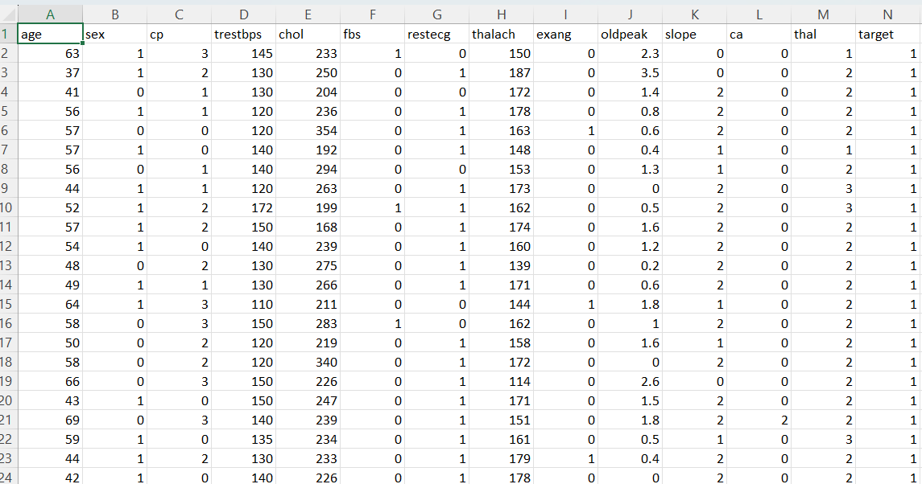
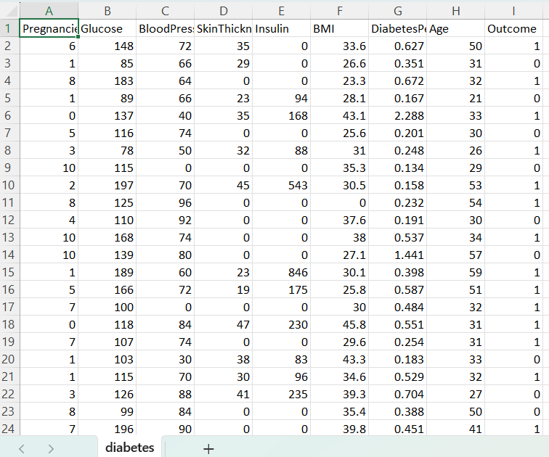
MODULE 1: Data Collection and Preprocessing
Data Collection :
Effective data collection is fundamental for developing an accurate multi-disease prediction system. By integrating multiple sources, ensuring data quality, and addressing challenges, we can build a robust dataset that enhances model performance and prediction reliability.
The Dataset includes Diabetics dataset, Heart disease dataset and Perkins disease dataset.

Slide 11
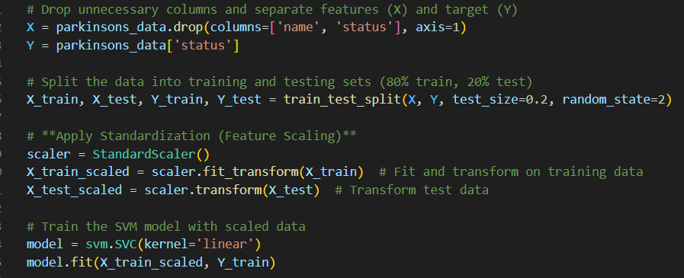
Data Preprocessing :
Cleaning and preparing the data for training, including standardization, augmentation, and handling missing or noisy data.
Processing steps may involve removing errors, handling missing values, and converting data into a structured format. Techniques like statistical analysis, machine learning, or other algorithms are often applied to uncover patterns or trends within the data.
Data exploration and Feature scaling is done.
Standardization:
Standardization is a preprocessing technique that transforms numerical features to have zero mean and unit variance. It ensures that all features contribute equally to the model by removing scale differences.
May 7, 2025
DEPARTMENT OF INFORMATION TECHNOLOGY / HEALTH FORECASTER MULTI-DISEASE PREDICTION SYSTEM

Slide 12
Module 2- Support Vector Machine model training Module
Step 1: Load Data
Before applying SVM, we need to load the dataset and preprocess it. This includes:
Removing missing values
Encoding categorical variables
Splitting the data into features (X) and target labels (Y)
Step 2: Choose a Kernel Function
SVM uses kernels to find the best decision boundary between classes. The choice of kernel depends on data distribution:
Linear Kernel → When data is linearly separable
Polynomial Kernel → When data has complex boundaries
RBF (Radial Basis Function) Kernel → When data is non-linearly separable
Step 3: Train SVM Model
Once we choose a kernel, we train the model on the training data. C (Regularization Parameter) controls the trade-off between margin size and classification errors.
Gamma (for RBF/Polynomial kernels) controls how much influence a single data point has.

Slide 13
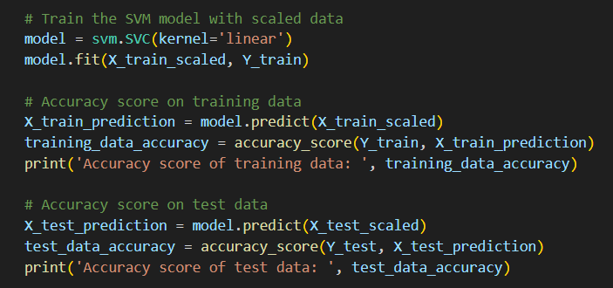
Module 2-Support Vector Machine model training Module
Step 4: Make Predictions
After training, we use the model to predict labels for new data points.
For a new input, we preprocess and reshape it before making a prediction.
Step 5: Evaluate Performance
To assess model accuracy, we use classification metrics:
Accuracy → Measures overall correctness
Precision → Measures how many predicted positives are actually correct

Slide 14
MODULE 3: User Interface Module
The User Interface (UI) module is a crucial part of your multi-disease prediction system. It serves as the front-end interface where users (patients, doctors, etc.) input their medical data and receive predictions from the machine learning model. Using Streamlit, a Python-based web app framework, you can quickly build an interactive, user-friendly UI without needing deep web development knowledge.
Disease Selection & Navigation Users select the disease to predict (e.g., diabetes, heart disease) via a sidebar or menu.
Input Collection Streamlit displays relevant input fields for user medical data (e.g., age, blood pressure, glucose level).
Prediction Trigger A button is clicked to submit the inputs, which are passed to the ML model for prediction.
Result Display The predicted outcome is shown clearly on the screen, possibly with advice or confidence score.
May 7, 2025
DEPARTMENT OF INFORMATION TECHNOLOGY / HEALTH FORECASTER MULTI-DISEASE PREDICTION SYSTEM

Slide 15
IMPLEMENTATION
Architecture Diagram
Use Case Diagram
Activity Diagram
Sequence Diagram

Slide 16
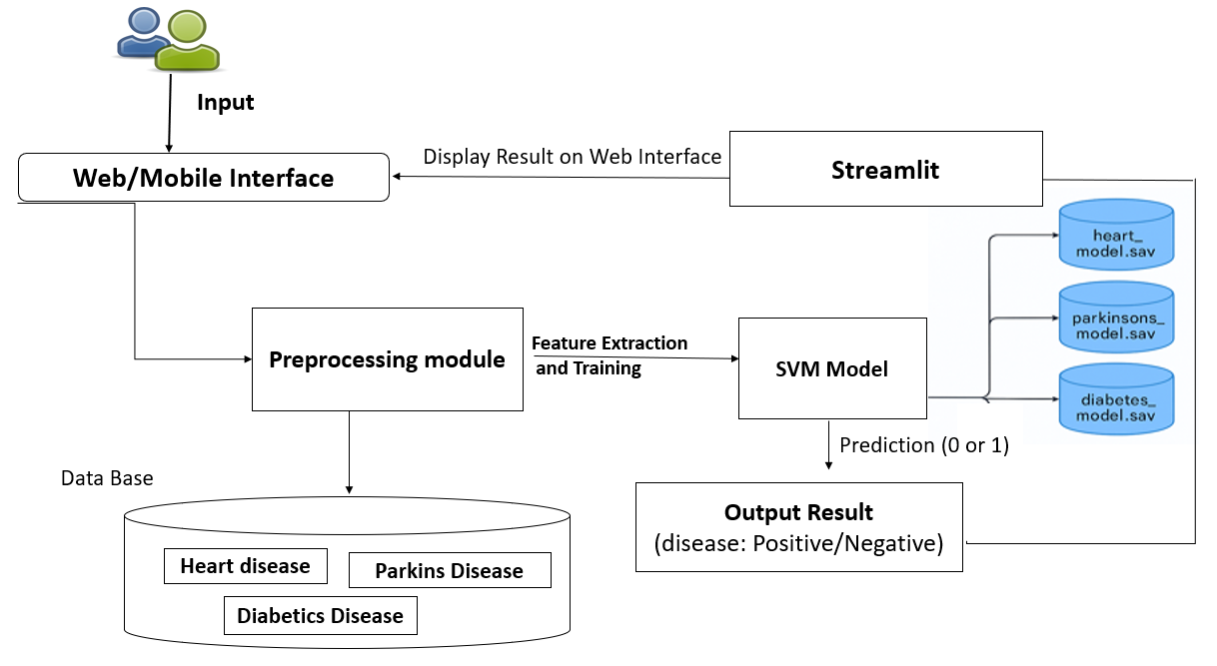
Architecture Diagram

Slide 17
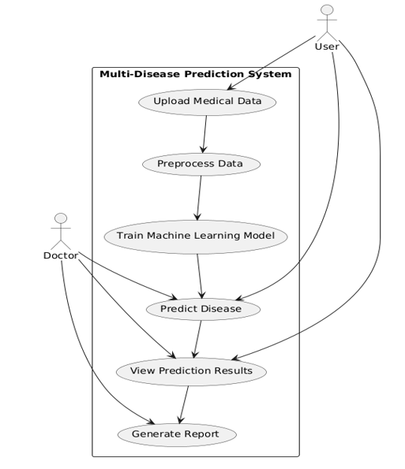
Use Case Diagram
,

Slide 18
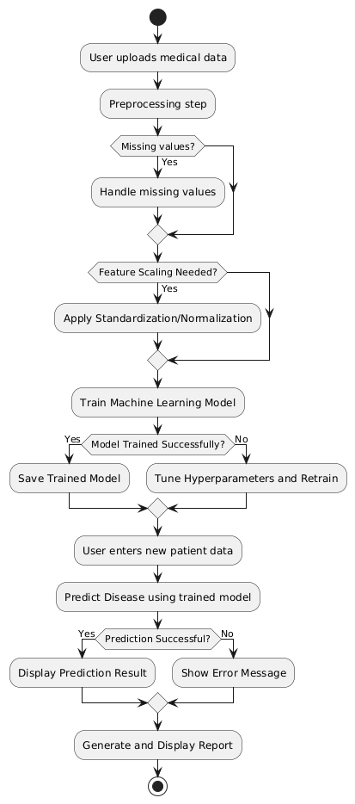
Activity Diagram
,

Slide 19
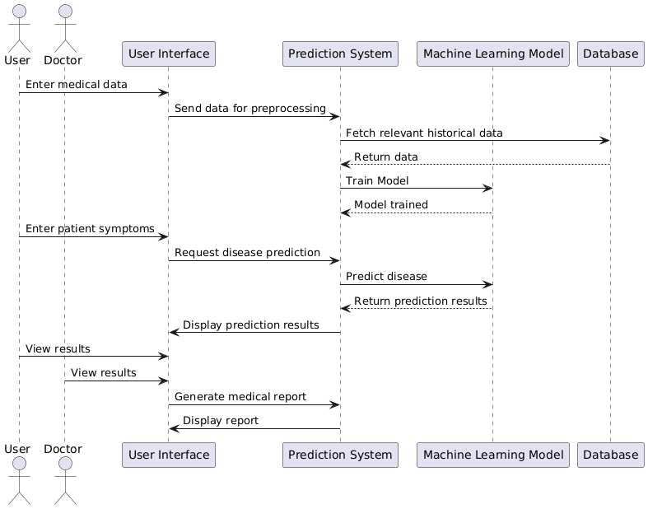
Sequence Diagram
,

Slide 20
TESTING METHODOLOGIES
In software development, especially in machine learning systems like a multi-disease prediction system, testing ensures that individual components work correctly and that the system behaves as expected when all components are integrated. The two main types of testing used are:
Unit Testing
Integration Testing
DEPARTMENT OF INFORMATION TECHNOLOGY / HEALTH FORECASTER MULTI-DISEASE PREDICTION SYSTEM

Slide 21
UNIT TESTING
Unit testing in machine learning involves testing individual components of your system to ensure each part behaves as expected. For a multi-disease prediction system using a Support Vector Machine (SVM), this means testing functions such as data preprocessing, model loading, prediction logic, and error handling.
Testing Data Preprocessing: Verify that valid inputs are correctly transformed into a format accepted by the SVM model.
Testing Model Prediction: Ensure the model returns a prediction of the expected shape and data type.
Testing the Prediction Function: Verify that the top-level function predict_disease() integrates preprocessing and prediction correctly.
Testing Edge Cases and Errors: Ensure that the system behaves predictably for unusual or invalid input.
Tools for Unit Testing
Python unittest: Built-in module for writing and running test cases.
pytest: More advanced framework with better output and flexibility.
Pickle: Used to load pre-trained SVM models during testing.
May 7, 2025
DEPARTMENT OF INFORMATION TECHNOLOGY / HEALTH FORECASTER MULTI-DISEASE PREDICTION SYSTEM

Slide 22
INTEGRATION TESTING
Integration testing involves testing how multiple components of a system work together as a whole. In the case of a multi-disease prediction system, it ensures that the data flow, function execution, and model prediction pipeline function smoothly from end to end.
Validate that all modules (e.g., preprocessing, model loading, prediction, and output formatting) work in coordination.
Catch interface issues or data mismatches between components that unit tests might miss.
Ensure that the full prediction pipeline is robust for different kinds of inputs.
Tools & Frameworks for Integration Testing
unittest or pytest: Can be used to write full-pipeline test cases
Streamlit API test clients: For API-based systems, test using the client interface
Mocking tools: To simulate inputs or intermediate steps if needed
May 7, 2025
DEPARTMENT OF INFORMATION TECHNOLOGY / HEALTH FORECASTER MULTI-DISEASE PREDICTION SYSTEM

Slide 23
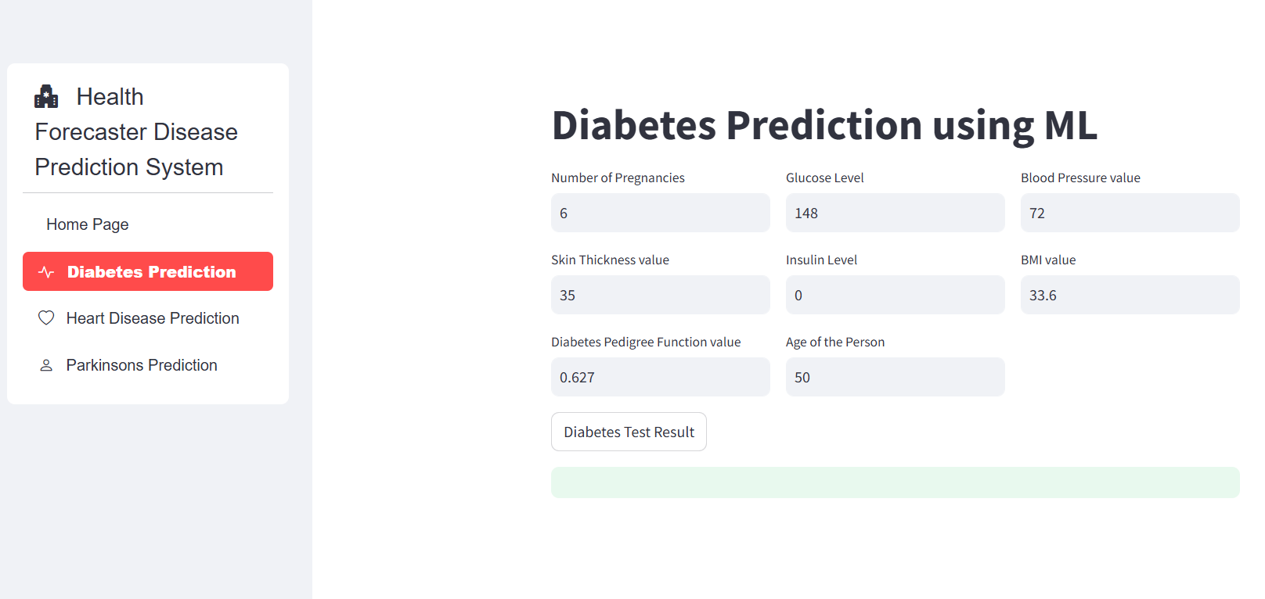
INPUT

Slide 24
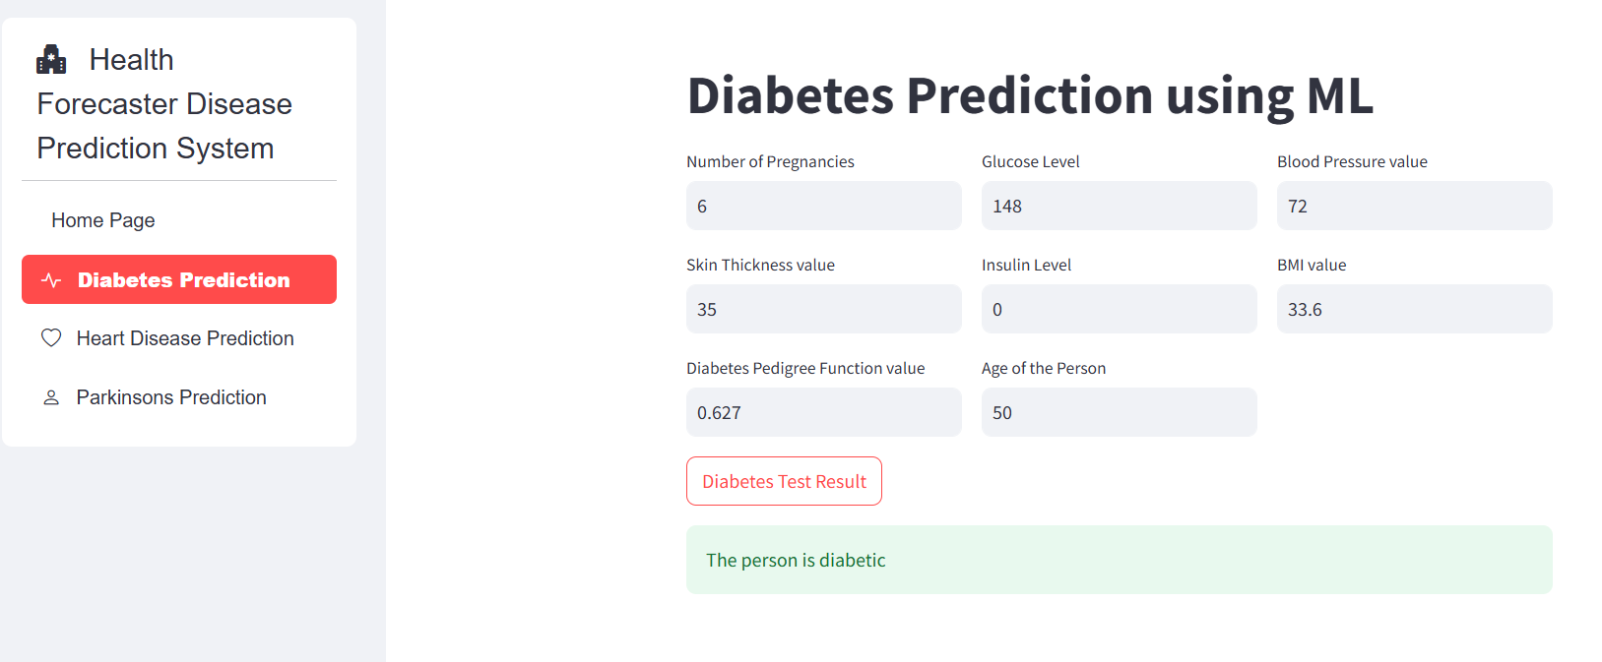
OUTPUT

Slide 25
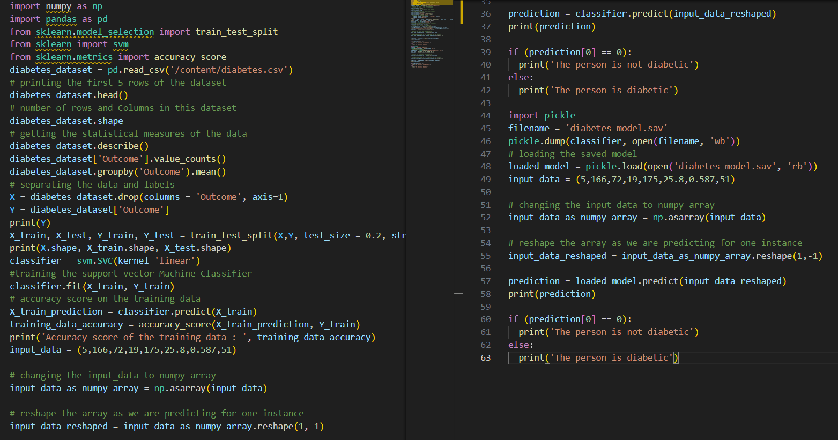
SOURCE CODE

Slide 26
CONCLUSION
The Multi-Disease Prediction System using Machine Learning provides an efficient and accurate approach to early diagnosis and risk assessment of multiple diseases. By leveraging data preprocessing, feature selection, and machine learning algorithms, the system can analyze patient data and provide reliable predictions.
Encourages individuals to adopt preventive health measures by identifying potential risks early. Early disease prediction and management reduce complications, enabling individuals to lead healthier and longer lives.
This aids healthcare professionals in making informed decisions, improving early detection, and enhancing treatment planning.
With further improvements in data collection, model optimization, and real-time integration, the system can become a valuable tool in predictive healthcare, reducing diagnosis time and improving patient outcomes.
Educates individuals about their health risks and the importance of preventive care, fostering a health conscious society. Promotes self-responsibility for health by offering actionable insights and recommendations.
Future advancements in deep learning and AI-driven diagnostics can further enhance accuracy and adaptability across diverse medical conditions.

Slide 27
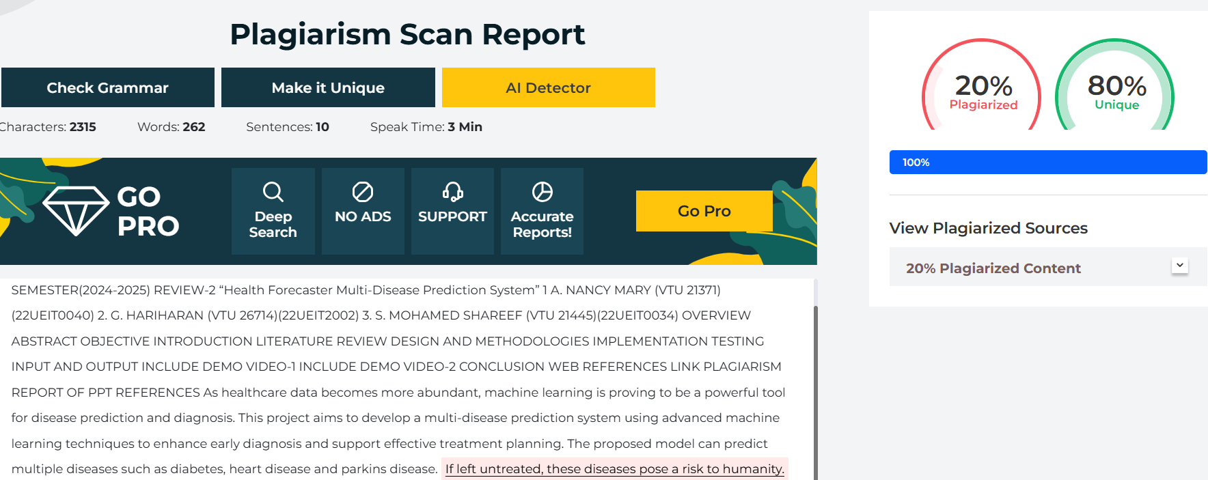
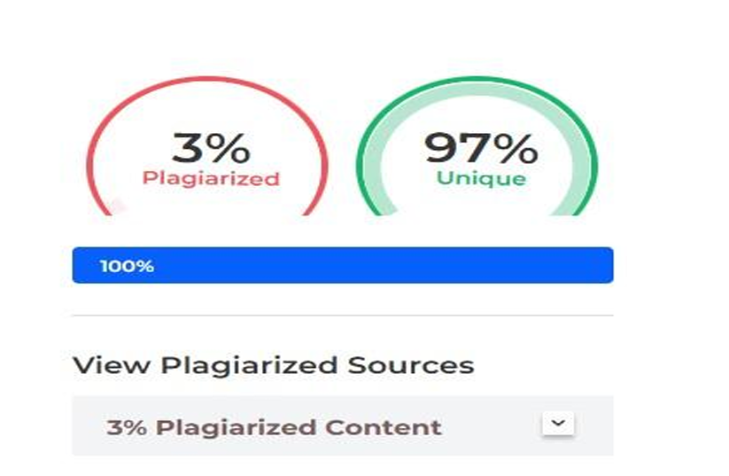
Plagiarism Report of PPT

Slide 28
Web Reference
https://www.kaggle.com/datasets
https://ieeexplore.ieee.org/
https://www.tensorflow.org/tutorials/images/cnn
https://streamlit.io/
https://youtu.be/8Q_QQVQ1HZA?si=pzHnDOFvpLXuC_Ee
https://www.youtube.com/live/YzvMpvXyUfs?si=JkcGlByyhs3D3I3c
May 7, 2025
DEPARTMENT OF INFORMATION TECHNOLOGY / HEALTH FORECASTER MULTI-DISEASE PREDICTION SYSTEM

Slide 29
REFERENCES
Amit Kumar, S. R. Sandeep, and Kavitha N., "Multiple Disease Prediction System Using Machine Learning and Deep Learning Algorithms", International Journal of Novel Research and Development, Volume 8, Issue 4, April 2023, pp. 270-275.
V. Rajagopal, M. S. Anisha, and R. Soundarya, "Multi-Disease Prediction System Using Machine Learning", International Journal of Novel Research and Development, Volume 8, Issue 4, April 2023, pp. 270-275.
S. Prakash, R. Vignesh, and A. Krishnakumar, "Multiple Disease Prediction Using Machine Learning", International Journal of Novel Research and Development, Volume 8, Issue 4, April 2023, pp. 270-275.
B. Sharma, A. Tiwari, and S. Gupta, "Multi Disease Prediction Model by Using Machine Learning and Flask API", International Journal of Novel Research and Development, Volume 8, Issue 4, April 2023, pp. 270-275.
K. Patel, P. Shah, and R. Mehta, "Multiple Disease Prediction Based on User Symptoms Using Supervised Classification Algorithms", International Journal of Novel Research and Development, Volume 8, Issue 4, April 2023, pp. 270-275.

Slide 30
REFERENCES
6. S. Taheri and M. Mammadov, “Learning the naive Bayes classifier with optimization models, ” IEEE Transactions on Computer Science, volume 23, no. 4, pp. 787–795, December 2023.
7. T. Vivekananda and N. C. S. N. Iyengar, ”Optimal feature selection using a modified differential evolution algorithm and its effectiveness for prediction of heart disease,” Compute. Biol. Med., volume 90, pp. 125–136, November 2017.
8. M. Pradhan and G. R. Bamonte, “Design of classifier for detection of diabetes mellitus using genetic programming,” in Proc. 3rd International conference Frontiers Intel, pp. 763–770, November 2015.
9. S. Dey, R. R. Paul, and S. A. N. Parah, "Diabetes Prediction using Machine Learning Algorithms," 2020 4th International Conference on Electronics, Materials Engineering & Nano-Technology (Imtech), Kolkata, India, pp. 1-5, 2020.

Slide 31
THANK YOU

